Slide 1
Welcome Everybody

Slide 2
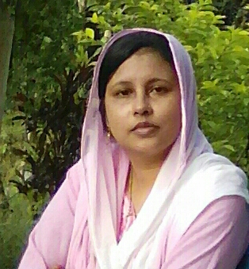
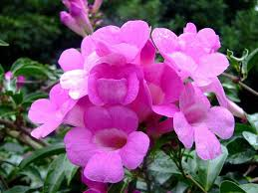
Rafeya Akter Happy
Assistant Teacher
A.M.Government Primary School
Hatiya,Noakhali
Class:Three
Subject:English
Lesson: Introducing A Teacher
Unit:34
Time:45 minutes

Slide 3
Let’s watch the video
Who is introducing himself?
What is today’s lesson might be?

Slide 4
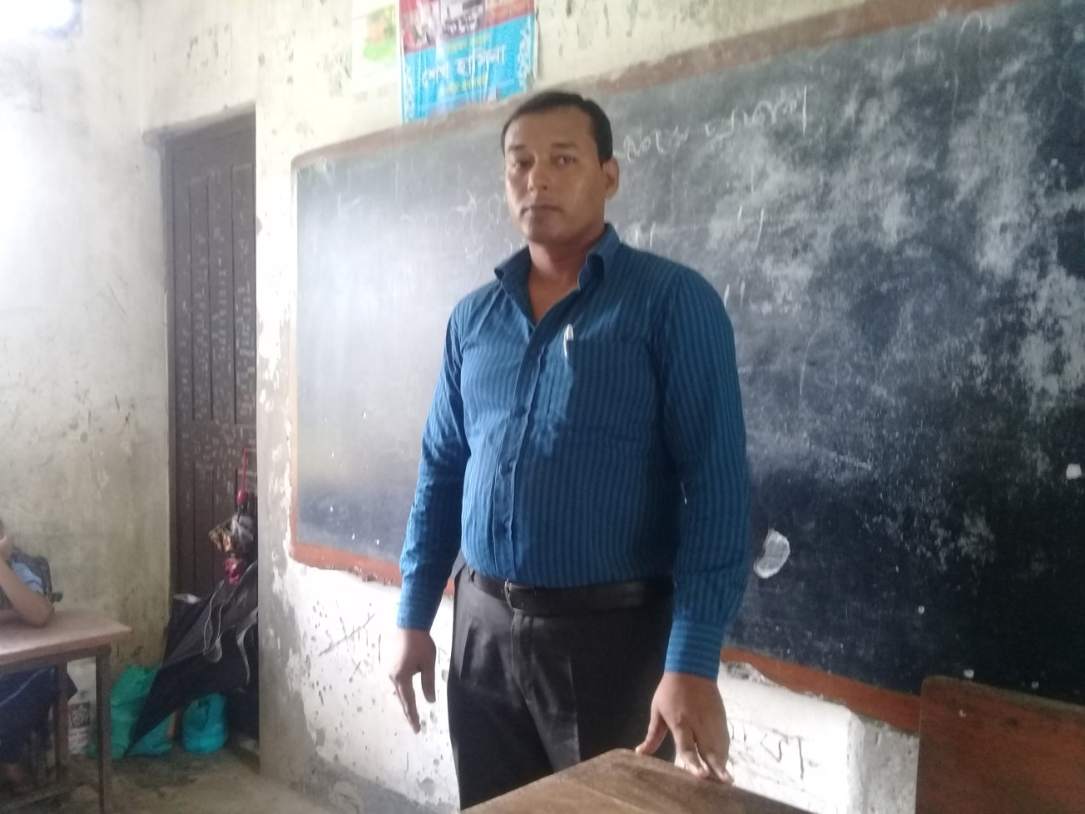
Todays lesson is----
Introducing a Teacher

Slide 5
Learning outcomes-------
Students will be able to-----
read the texts with proper pronunciation, stress and intonation.
spell the words( teacher ,work and primary )and use in sentences.
write about people.

Slide 6
This is Mahbub Alam.

Slide 7
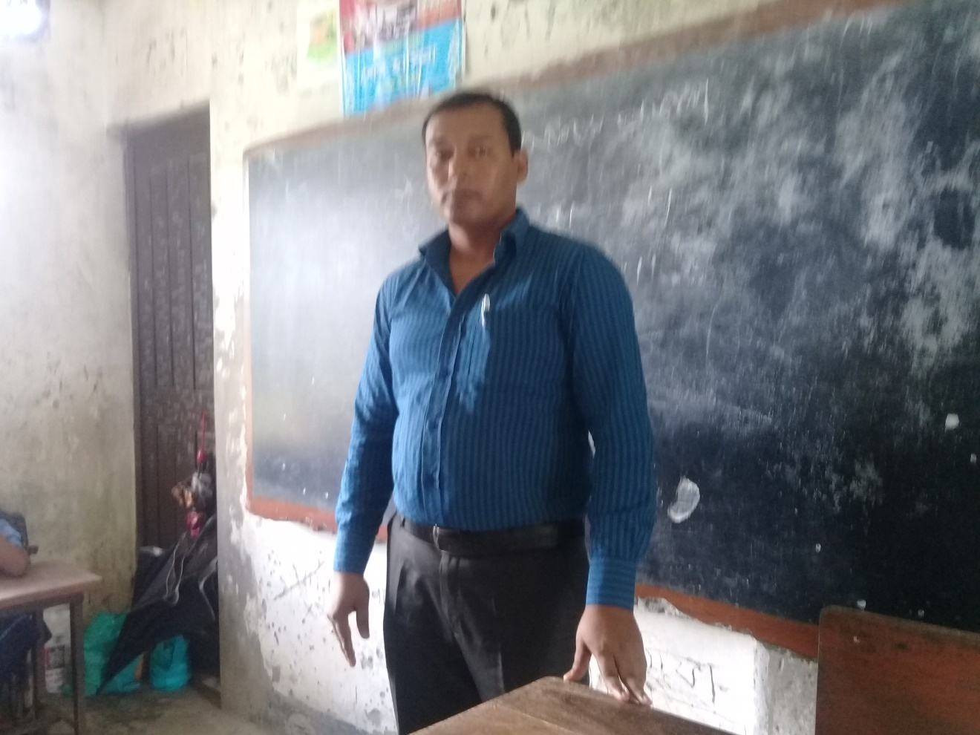
He is30 years old.

Slide 8
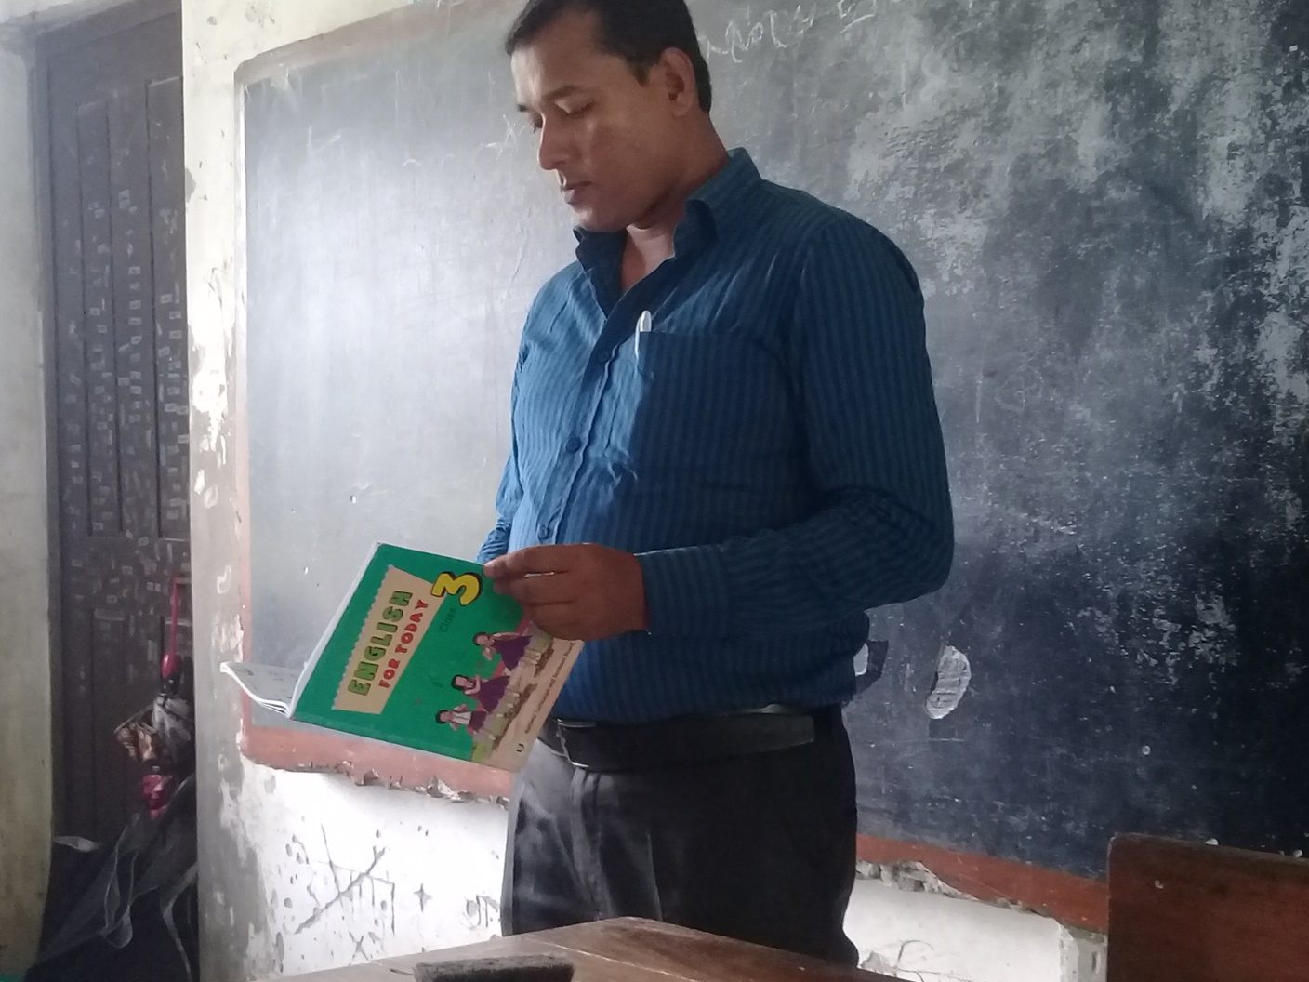
He is an English teacher.

Slide 9
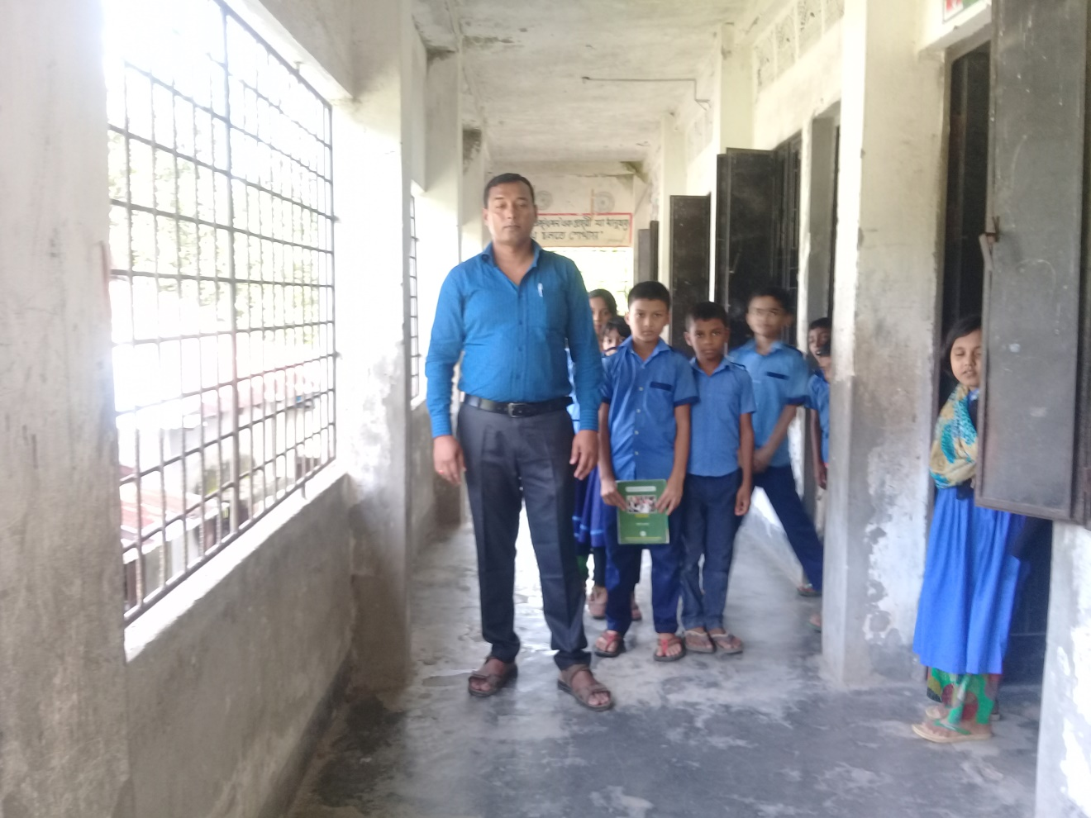
He works in a primary school in Narail.

Slide 10
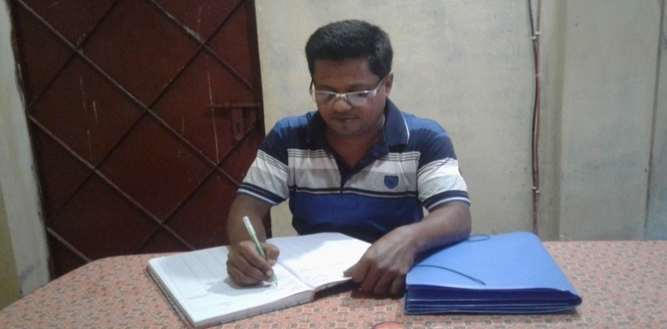
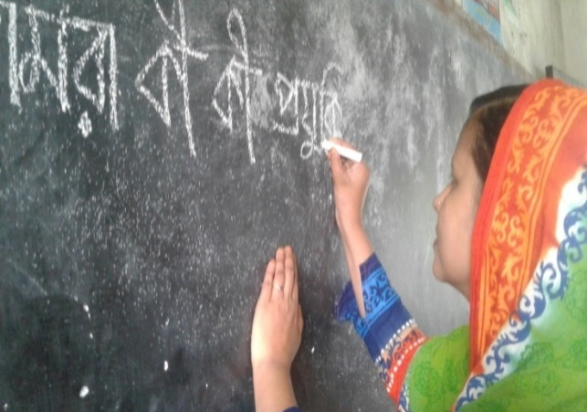
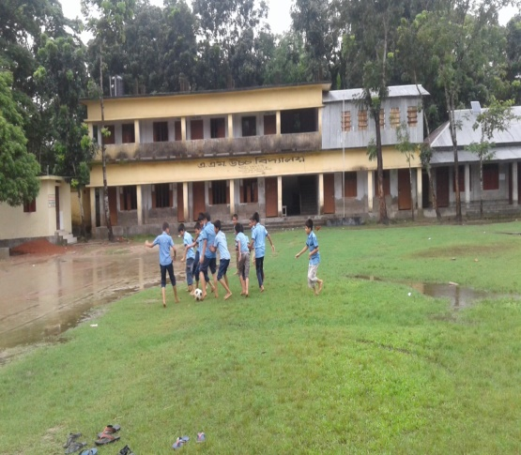
New words with sentences(by using sentences)
Word
Meaning
Tasks to be undertaken
Work
He works in a office.
A person who teaches students
Teacher
She is a teacher.
Directly derived from the first stage of development
Primary
He is a primary school teacher.

Slide 11
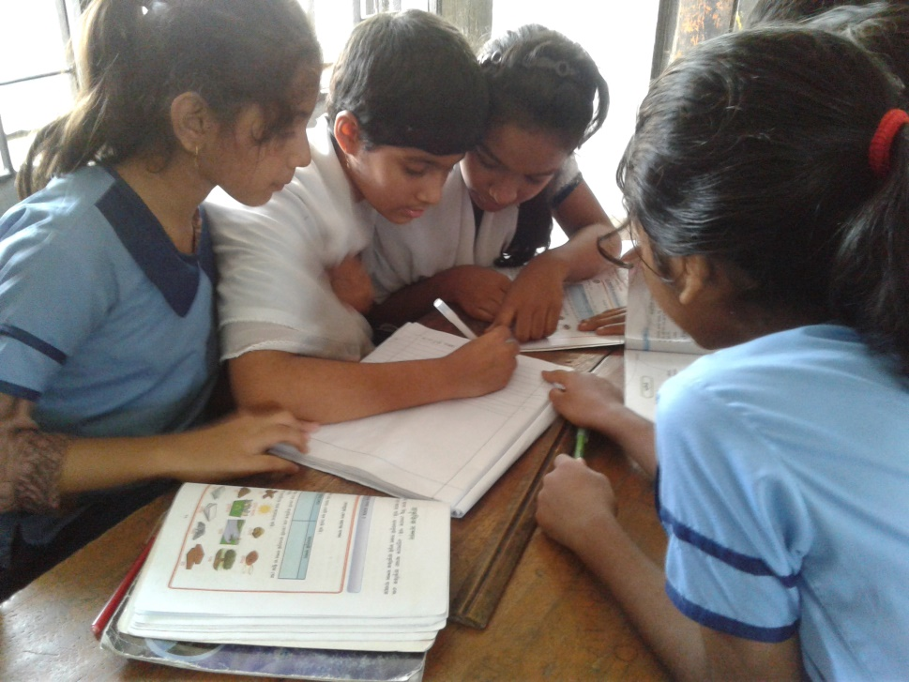
Lets play a game
Time:5 minutes
Jumble word game
Arrange the letters
Rwok,ldo,ctaehre,rpiamry

Slide 12
Let’s listen my audio

Slide 13
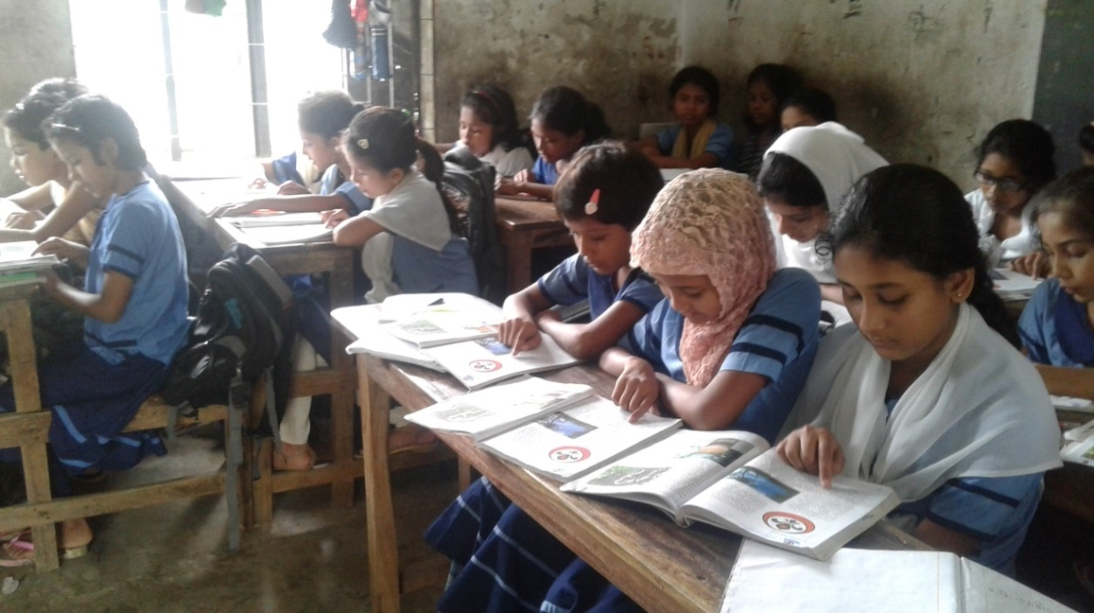
Silent Reading

Slide 14
Match the words with their similar meaning (gw)
Time:5 minutes
Teacher Tasks to be Undertaken
Work Directly derived from the first stage of
Primary a person who teaches students
development

Slide 15
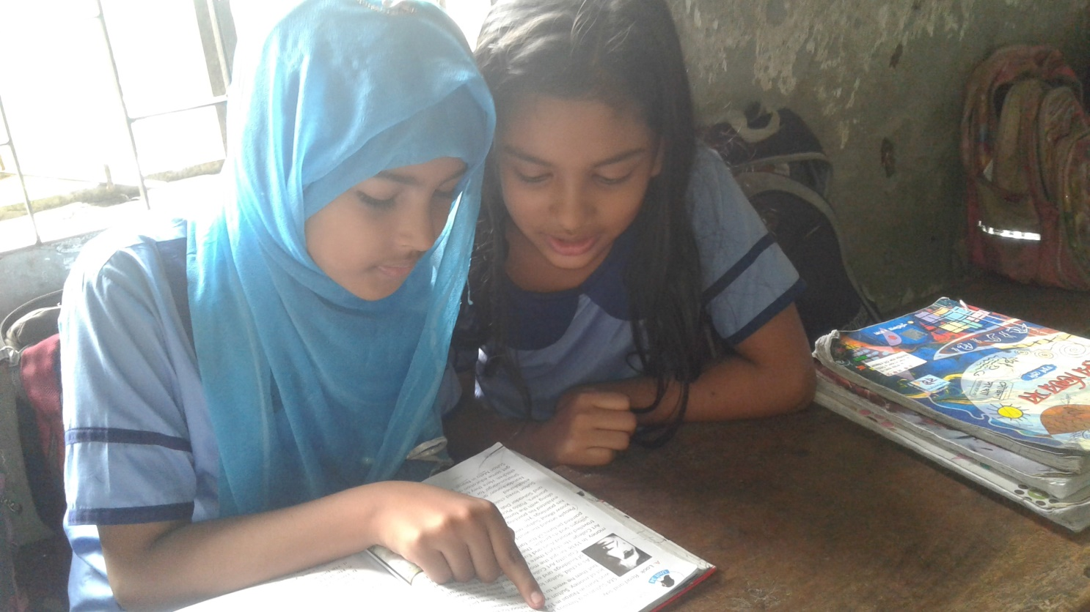
One read and another listen(pw)
Time:5 minutes

Slide 16
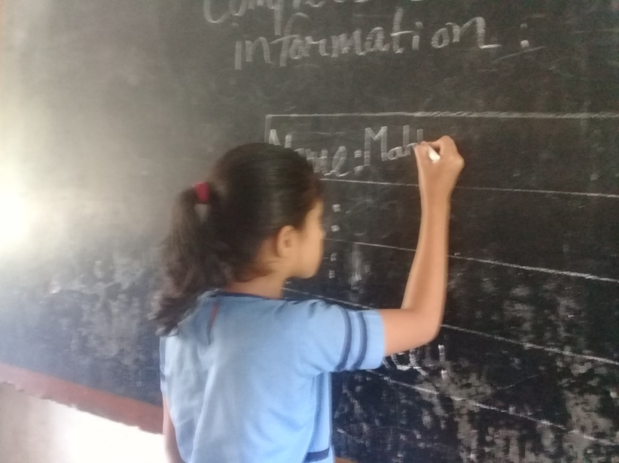
Complete the table on blackboard with Mahbub’s information(iw)
Time:5 minutes
Name:
Age:
Job:
Work place:

Slide 17
Evaluation
Answer the questions
What is the persons name?
How old is he?
What does he do?
Where does he work?

Slide 18
Thanks a lot
See you

